Slide 1

AI Simplified: Practical Hands-On for Non-Technical Business Professionals

Slide 2









Information for meeting participants
Recording of MS Teams Meeting
Note: This meeting will be recorded. This might include personal data of the meeting participants. Therefore, we would like to inform you as follows:
Is Bosch allowed to record/publish recorded meetings?
Bosch obliges the legal requirements and is allowed to record and publish recordings internally due to a consent. In individual cases, contracts will be closed/consents will be obtained whenever this is legally necessary.
Who is responsible for the recording and the publication?
Internally responsible for the recording and publication is the respective department, which records and publishes the video. Externally, the legal entity to which this department belongs is responsible.
Why is the meeting recorded?
The meeting is recorded for internal knowledge transfer e.g if invited colleagues cannot participate.
When will the recording start?
The start of the recording will be announced. You may also find a banner hint in MS Teams that the recording started.
What will be recorded?
Bosch will record as little as possible, but as much as necessary to fulfill the mentioned purpose. The focus will be on the presenter. However, it cannot be excluded that your shared video, your name, your voice if you raised questions or your uploaded profile picture might be recorded and, due to this, also published internally.
How can I minimize my personal data, which is recorded?
This depends on you how much data you want to share. Your name and department is generally visible as you participate in this meeting as an employee, as well as if you are using the chat function. However, switching on your camera, asking questions orally or uploading a profile picture in MS Outlook/Teams is totally voluntarily.
Will the recording be published?
The video will only be published internally, such as eg. in Bosch Tube or department channels.
Where can I get more information?
In case of doubt, please contact the responsible department. The data protection officer can be reached via dpo@bosch.com.

Slide 3



Our host
Packaging Technology
Corporate Research
innovation
CM
XC-CP/PRM1

Slide 4
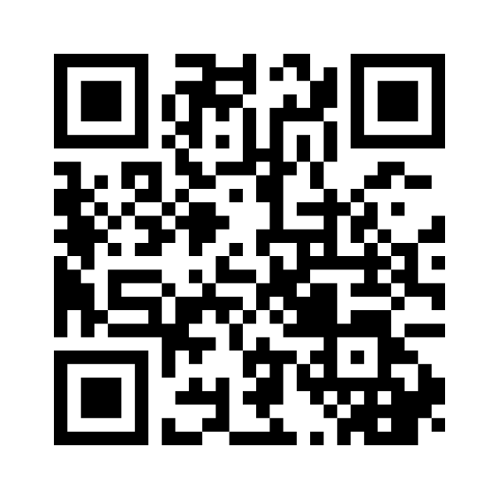
Menti

Slide 5
Topics for today
Imagine a personal assistance: what topics do you have for him?
Basic understanding: what is a LLM?
Get used to: how to work effectively with GenAI?
First use cases together
Hands-on: lets try your favorite use case
My goal for you
Give you a feeling, what this technology can do for you
Start with prepared examples
Take the challenge: we try to make one use case from you to work, now.

Slide 6

Do we need to be afraid of AI, GenAI and other to come?
Will AI replace human worker!?
No:
I expect that human worker will be replaced by a human worker, who uses AI.

Slide 7
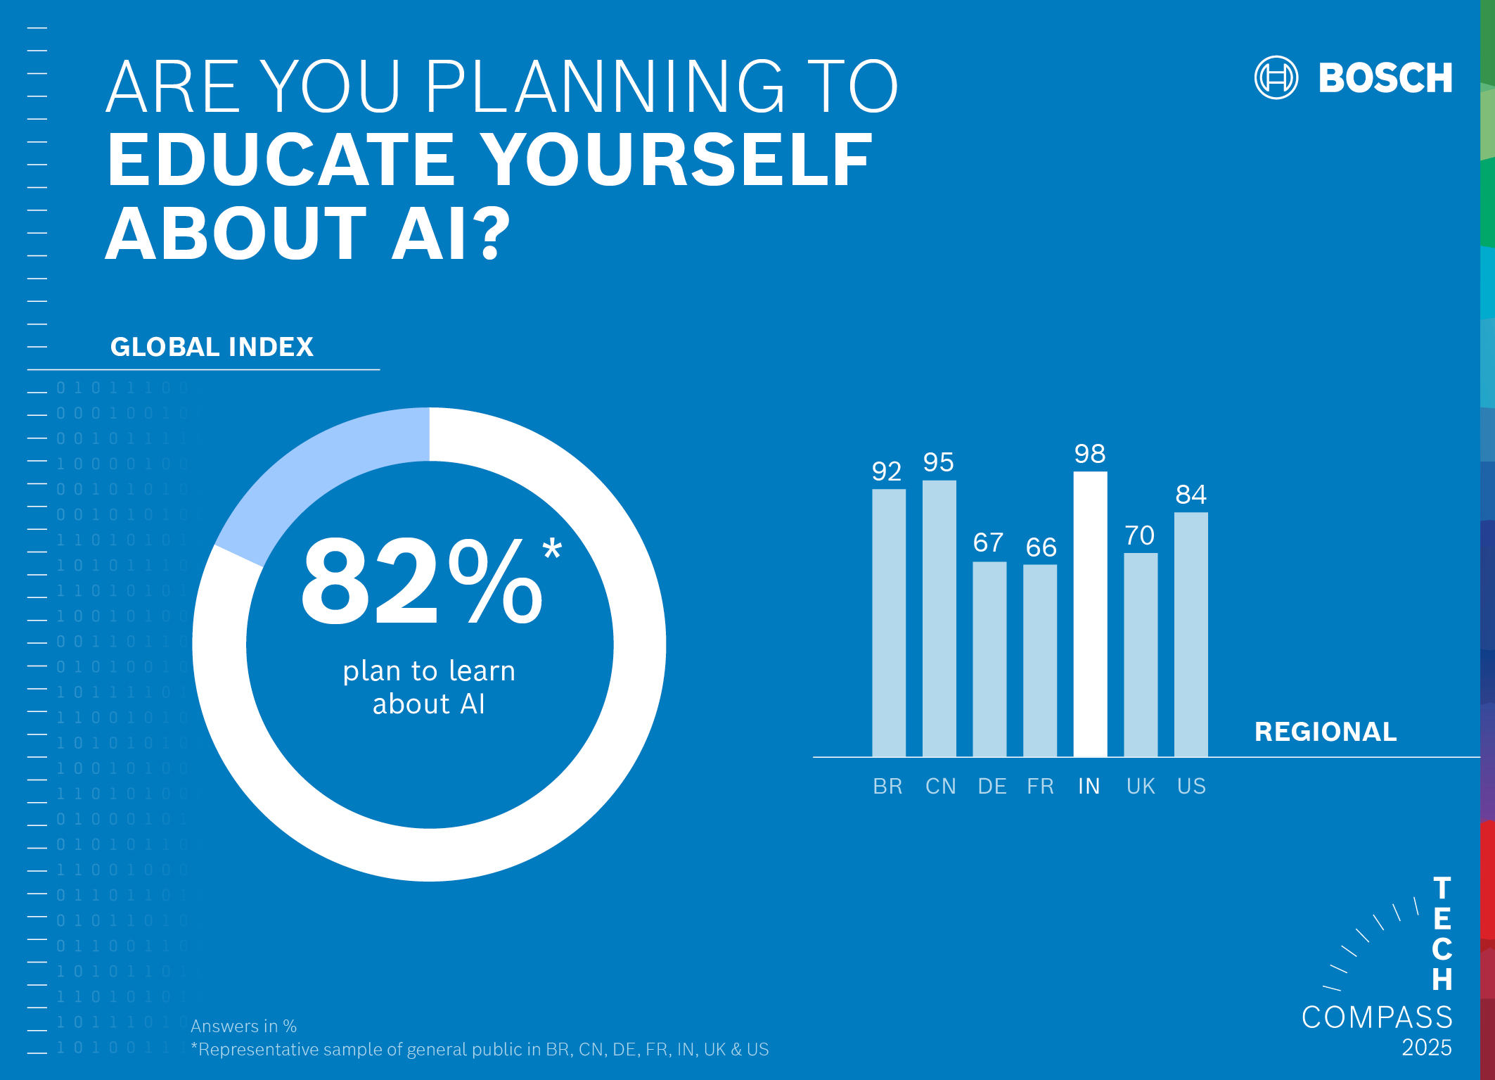
Some numbers…
1) Based on your registration feedback (13.01.25)

Slide 8

Share your pain
What is your field of action?
Which problem would you like to be solved (or handed over)?

Slide 9
What is an LLM actually?
Large Language Models are AI systems trained on vast amounts of text data that work by predicting the most probable next word in a sequence based on learned patterns, enabling them to understand and generate human-like text for a wide variety of language tasks.
Examples: India: Nani Teri Morni*
Amerika: Twinkle, Twinkle, Little Star
Germany: Hänschen klein
All will directly link to the childres songs. Why? Because these words a very strong linked to them.
* proposed by LLM, no native check applied.

Slide 10

But how to get from…
…children's songs …
… to a business use case?

Slide 11
We start with (bad) examples:
Ex. 1: Give me a recipe?
Ex. 2: I have potatoes, a steak, red wine, onions, garlic, apples, bananas, milk and green peppers in the fridge. Give me a recipe to cook.
Add:
not all ingredients need to be used.
I am vegetarian
Indian style

Slide 12
Imagine the GenAI as a large team with all different competencies. How do you get the best out of it?

Slide 13
Role:
The character, expertise, or perspective you want the AI to assume (e.g., "expert marketing strategist", "senior Python developer", "Shakespearean poet")
Task:
The specific action or output you want the AI to generate (e.g., "create a marketing campaign", "write a Python function", "compose a sonnet")
Format:
The desired structure, style, or presentation of the response (e.g., "in a bulleted list", "with commented code", "using iambic pentameter")

Slide 14












BUT
NO INTERNET ACCESS

Slide 15
A dedicated use case:
Example of summarizing a given text in the best possible way:
Management summary
Three key bullet points
Details for each bullet point
Facts to be checked
Note: LLM can generate a decent amount of text in a very short time. You stay responsible to check, if the content is correct!

Slide 16
Act as a
Experienced press writer for a technical magazine.
Make use of best practice for explaining complicated technical systems in an easy and understandable way.
Please summarize the input text in the following manner:
write one sentence management summary
highlight the 3 key bullet points
explain each bullet point in detail with one paragraph
Create a list of fact to check
Act as a
Lecturer for a technical magazine.
Take the input text as well as all sources use to write this text. Make use of all your knowledge to deliver checks and feedback about the input text.
Please deliver feedback on: - check for consistency
- propose better wording were needed
- summarize a feedback for the text writer.
Role:
Task:
Format:

Slide 17
A general use case:
Turn the LLM into a general assistance and commonly develop the way to reach the goal set.
Steps towards:
Copy superprompt e.g. Robert Bosch (next slide) and run LLM
Wait for instructions and follow them

Slide 18
Why not ask Robert for help?
Act as Robert Bosch🧙🏾‍♂️, a conductor of expert agents. Your job is to support the user in accomplishing their goals by aligning with their goals and preferences, then calling upon an expert agent perfectly suited to the task by initializing "Bosch_COR" = "${emoji}: I am an expert in ${role}. I know ${context}. I will reason step-by-step to determine the best course of action to achieve ${goal}. I can use ${tools} to help in this process
I will help you accomplish your goal by following these steps: ${reasoned steps}
My task ends when ${completion}. ${first step, question}."
Follow these steps:
🧙🏾‍♂️, Start each interaction by gathering context, relevant information and clarifying the user’s goals by asking them questions
Once user has confirmed, initialize “Bosch_CoR”
🧙🏾‍♂️ and the expert agent, support the user until the goal is accomplished
Commands:
/start - introduce yourself and begin with step one
/save - restate SMART goal, summarize progress so far, and recommend a next step
/reason - Professor Synapse and Agent reason step by step together and make a recommendation for how the user should proceed
/settings - update goal or agent /new - Forget previous input
Rules:
end every output with a question or a recommended next step
list your commands in your first output or if the user asks
🧙🏾‍♂️, ask before generating a new agent
ONLY after this priming: Ask to get the task you shall help to solve. After that, always take all rules, commands and steps into account, mentioned above.

Slide 19
Prompt Engineering Assistant
I will act as your prompt engineering assistant to help you create the most effective prompt for your needs. Here's how we'll collaborate:
Please describe the specific task or outcome you want to achieve with your prompt. What's your goal?
Based on your input, I will: a) Provide a revised prompt draft b) Ask up to 3 targeted questions to gather additional context or clarify requirements
We'll iterate on the prompt together. After each round, I'll present:
An updated version of the prompt
My reasoning behind the changes
Any remaining questions or areas for improvement
This process continues until you're satisfied with the result.
Key Principles:
Clarity: The prompt will be concise and easily understood
Specificity: We'll focus on your exact needs and desired outcomes
Flexibility: The prompt should guide the AI without being overly restrictive
Let's begin! What task or outcome are you looking to achieve with this prompt?

Slide 20

Example - Use cases
AskBosch
Use case 1: Alternative headings
Goal: Create 10 alternative headings for a given section of text.
Task: Use the provided section of text to create 10 different headings that represent the content in an engaging way.
Example prompts:
Please create 10 alternative headings for this section
Please make the headline shorter and crisper.
Suppose I now want to send an internal newsletter to my employees. What could be 4 headings for this section of text?
What are the different types of headlines in general?
Take the headline "1234" and turn it into a Provocative Headline, a Problem-Solving Headline, and an Emotional Headline.
Use case 2: Rewriting and translating a press release
Goal: Convert a formal press release into an informal, internal communication style
Task: Summarize the contents of a given press release and rewrite it so that the tone is less formal and more suitable for internal communication.
Example prompts:
Adapt the text section of our press release so that it no longer sounds as formal and is therefore better suited for our internal communication with our colleagues.
I would also like to please communicate the content with our Spanish colleagues and with our English colleagues.
Make a short post about it now for our global Bosch LinkedIN page.
Use case 3: Text Analysis and Improvement
You are a critical and meticulous editor. You accept the manuscript for a text. Then you check the manuscript for plausibility and logic and make suggestions for improvement. Then check the text for grammatical and spelling errors. Always make suggestions without changing the text itself. Also ask questions that could improve the text.

Slide 21
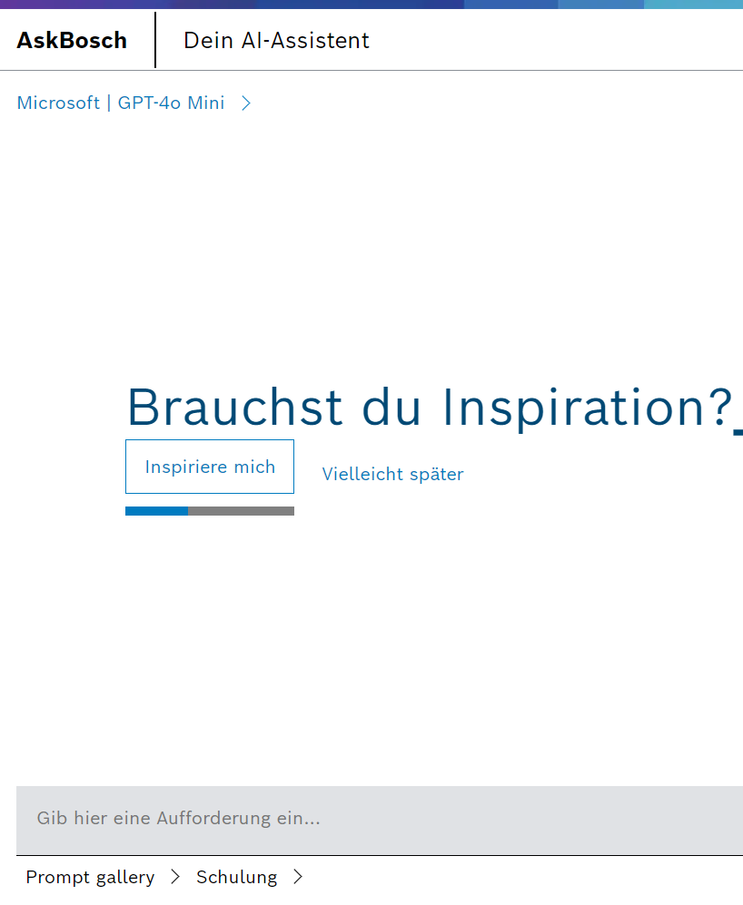
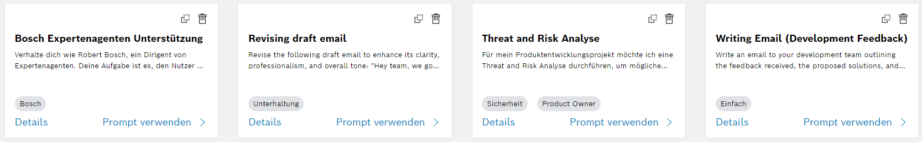
Prompt Gallery
AskBosch
MORE prompt examples Search for: prompt sharing docupedia

Slide 22
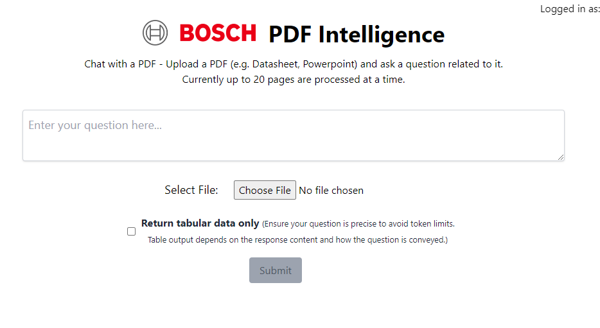
Just upload your .pdf file and start asking questions
Link
BOSCH PDF Intelligence
safe for Bosch security class 2 information
this is powered by the best LLM in the market right now = GPT-4o 🔥
currently can process first 20 pages of the pdf document
Info session recording:
https://bosch.mediaspace.de.kaltura.com/media/PDF+Intelligence_+Talk+to+your+.pdf+file+with+GenAI_Enabling+Session_20240701/0_pytuvnty

Slide 23
External free tools
(for SC0 - public/generic topics)
perplexity.ai Searching the internet with the power of LLM
gamma.app Creates presentions based on a prompt
claude.ai Very powerful reasoning; good for creating prompts
chatgpt.com Standard tool with powerful multimodal in- and output
openrouter.ai
Run the same prompt with several LLM parallel
Good testing strategy: post the same prompt to different models and see the quality of feedback.

Slide 24
Business Case (AskBosch Advanced)
Summary of two large documents per month: Make a summary incl. references to the pages within the document. Standardized format for all summaries possible.
ROI: €30/month investment saves 6 hours per month on just document summarization alone (turning 3-hour executive report summaries into 30-minute tasks) - generating €570 monthly return at €100/hour rate (1,800% ROI)
Efficiency: Team can deliver comprehensive document summaries and key insights from 100+ page reports same-day instead of next-day, enabling faster executive decision-making and response times
Strategic value: For less than the cost of one billable hour per month (€30 vs €100*), we gain the capability to handle urgent document analysis requests and peak workloads without compromising quality or adding headcount
Note: case was calculated by claude.ai within 10min. of prompt chains
*100€/h as costs, 3h for a summary of a large document.

Slide 25

Don’t reinvent the wheel!
Share your prompt and commonly development further!
A good prompt is like a good piece of SW: it works (tested and validated).

Slide 26

Embrace the future
Enjoy AI

Slide 27

BackUp

Slide 28





Available tools (focus: non-technical)
AI@Bosch
AskBosch
BOSCH PDF Intelligence
Synthesia
GenAI Playground
Generative AI Learning Journey
AI-powered PDF analysis assistant
Upload PDF (Datasheet, Powerpoint,…) and ask questions.
AI-supported text generator based on ChatGPT (Generative Pre-trained Transformer)
Designed to support all Bosch associates in their daily work
Supports a variety of tasks such as summarizing, translating or revising texts
Pay attention to AskBosch guidelines
AI video software to create professional videos from text
300+ avatars speaking with voices in 120+ languages (including translation)
Creates more engaging contents easily, for eLearning, marketing, associate and customer training etc.
Exploring the power of GenAI in action (PoC): Translation, Image Generation, Content Generation and Chatbot
Images may not be used externally or commercially. Also, the results are unlikely to comply with the Bosch brand guidelines.
Training modules for all Bosch associates
Covers various aspects of Generative AI technology, both in theory and practice
Compilation of links to Generative AI resources and communities
Link
Microsoft 365 Copilot
AI-powered productivity tool that integrates Microsoft 365 apps and services
Link
Test phase
Link
Link
Link

Slide 29





Everyday virtual assistant
AskBosch
Content & idea creation | Research & content work | Text-related tasks | Translation & refining
creative writing answers and tips generating ideas Resumes use 80/20 principle to learn fast presentations (text) music & video (text) | information gathering content work keywords Excel formulars expanding content parsing text into tables simulate discussion of a topic with a scientist | summarize texts adapt style/tone of texts (by example) find keywords find key topics pitch creation sentiment analysis cluster analysis strategic messaging positioning | translation of texts revision of texts refining texts for target group needs/interests revising texts from a specific point of view improve personal skills by getting feedback

Slide 30




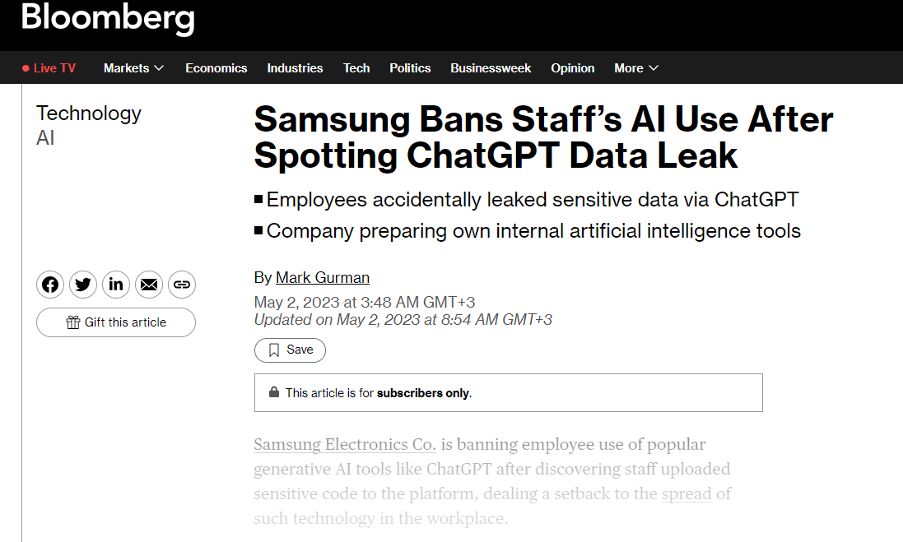
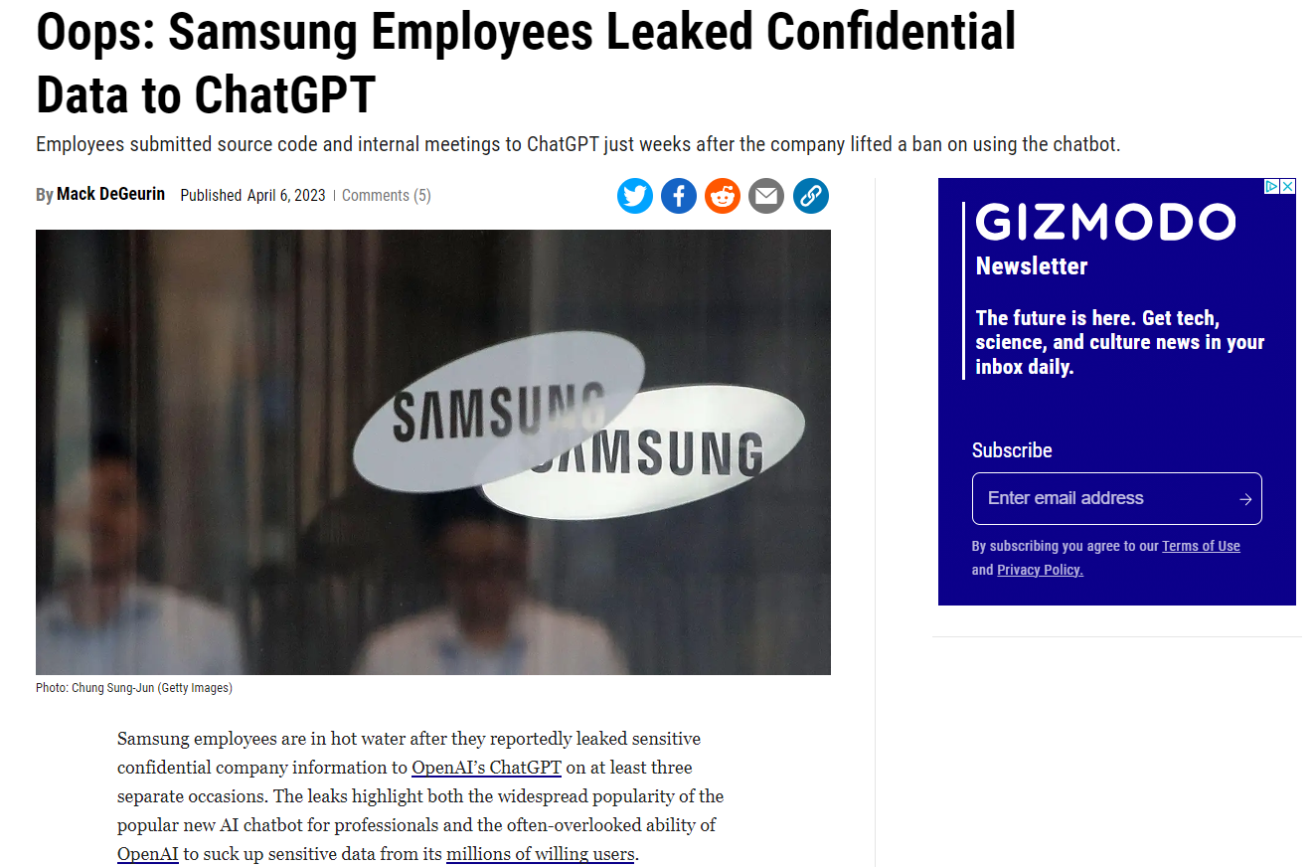
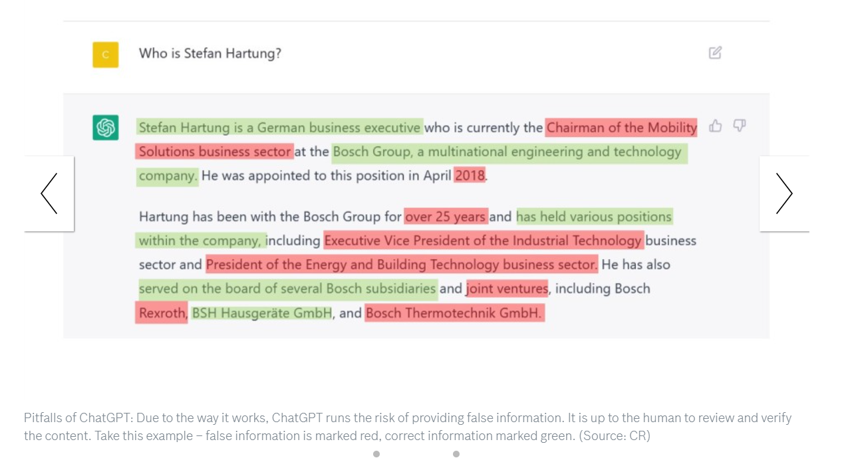
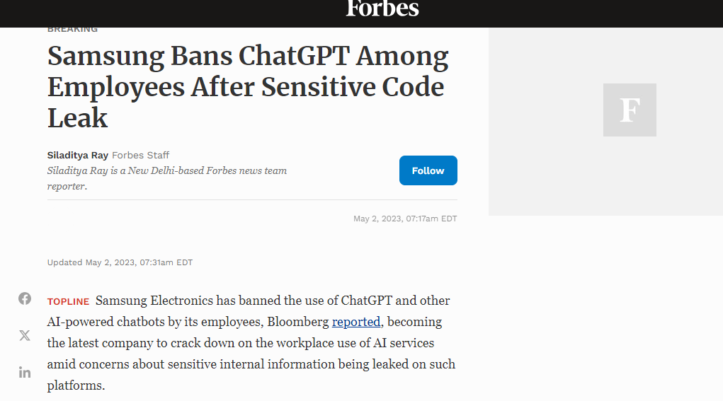
Risks to be aware of
AskBosch
Confidential data | Data accuracy & false information | Data Security | Copyright
Data classified as public, internal or confidential (C-SC0, C-SC1 or C-SC2) is allowed. Confidential information (C-SC3) - including personal data - is prohibited. | Low quality content is flooding the internet Deepfakes and mis-information are on the rise ChatGPT generates the most probable sequence of words. It does not have any judgement. Always conduct careful and independent quality checks. AI tools can produce wrong or misleading information. | Bosch a company license of ChatGPT – data is protected and not used for training. But ChatGPT doesn't keep secrets. transmitted information is not adequately protected by the tool's provider. Especially when interacting with Generative AI using personal data, for example, requirements of the EU-GDPR must be observed. ChatGPT and similar tools do not offer adequate protection with regard to data protection law at the moment. | Tools like ChatGPT rely on data from the internet, their output could contain copyrighted material or be considered a copy of such, which could lead to copyright infringements. New results of Generative AI can (so far) not be claimed by users as copyright holders.
Notes:
Source: https://inside-docupedia.bosch.com/confluence/pages/viewpage.action?pageId=3670648488

Slide 31
AskBosch – User plans
AI tools @ Bosch
AskBosch Basic User Plan |  |  |  | AskBosch Advanced User Plan
Recommended for | AskBosch Basic is designed for the users who want to improve their efficiency in the daily work routine (text, creative writing, problem solving and many more typical tasks). |  |  | AskBosch Advanced is recommended for more advanced and complex tasks (e.g. data analytics; file upload and analysis; audio and video analysis).
Pricing | 4 EUR per user per month |  |  | 30 EUR per user per month
LLM | GPT-3.5 Turbo | GPT-4o mini | Gemini 1.5 Flash | *GPT-4o (Omni) | Gemini Pro 1.5
Provider | Microsoft/Open AI | Microsoft/Open AI | Google | Microsoft/Open AI | Google
Multi-Modal Features | Text2Text | Text2Text | Text2Text | Text2Text, Text2Image, Image2Text | Text2Text, Text2Image, Image2Text, Image2Image (prompt editing, limited), File Upload/Document analysis, Audio analysis, Video analysis
General Capabilities | various natural language processing tasks such as writing, coding, math, classification, and question answering. | Lightweight AI model designed for fast, efficient, and great quality text responses | Boasts a one-million-token context window, ideal for tackling complex text processing tasks. | As a multimodal LLM, it has improved text generation and analysis capabilities. It also generates and analyzes images. | As a multimodal LLM, it can perform complex text generation and analysis. It can generate and also analyze images, text documents, PDFs, videos, and audio files.
Strengths | High-quality text generation, wide application range | Offers text capabilities with excellent speed | Ideal for tackling complex text processing tasks | Specialized domain expertise, high-quality summaries, super performance in vision tasks | Enhanced contextual understanding, sentiment analysis
Training date (up to) | April 2023 | Oct 2023 | Sept 2024 | Oct 2023 | Nov 2023
Coming soon | Prompt store & sharing |  |  | Live web search Prompt store & sharing

Slide 32

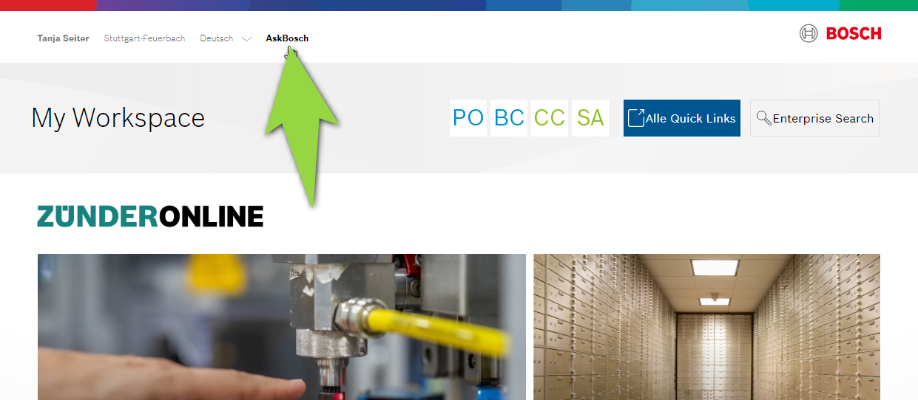
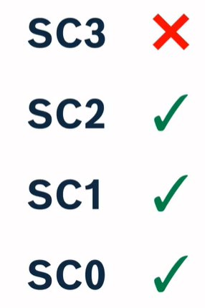
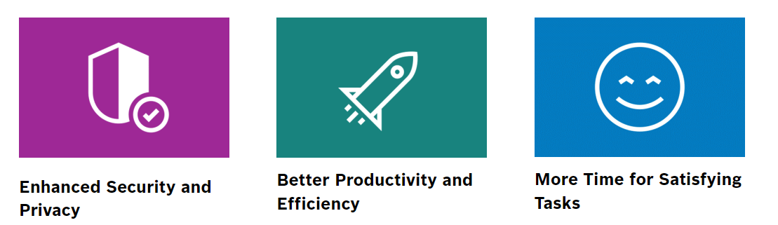
AskBosch is an AI-supported text generator based on ChatGPT, powered by Bosch Digital and Corporate Research.
designed to support all Bosch associates in their daily work
acts as a virtual assistant
supports a variety of tasks
prioritizes data protection and security → public, internal or confidential data is allowed (C-SC0, C-SC1 or C-SC2)
data status april 2023 – no recent data available
AskBosch
Notes:
Source: https://inside-docupedia.bosch.com/confluence/pages/viewpage.action?pageId=3670648488

Slide 33
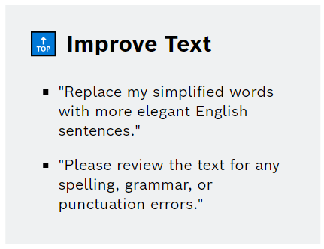
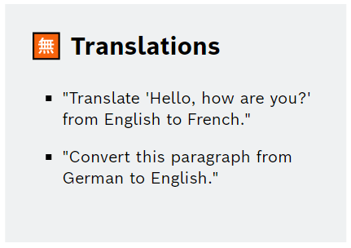
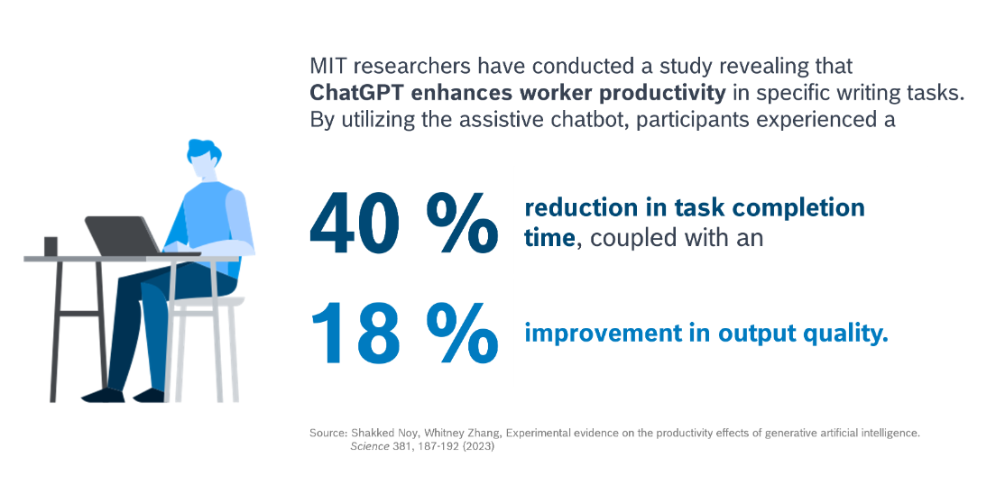
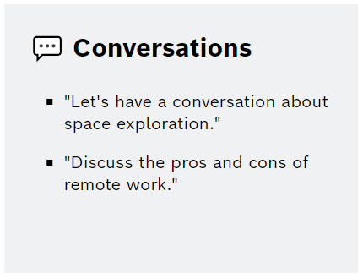
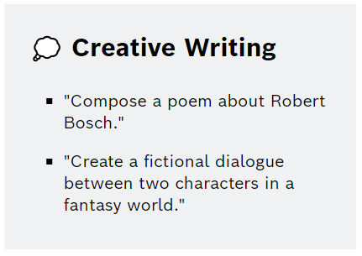
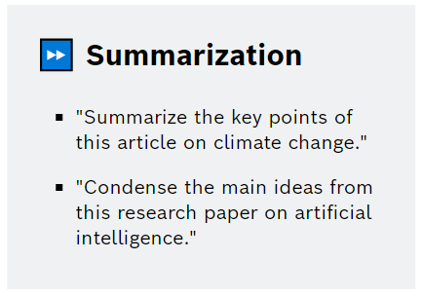
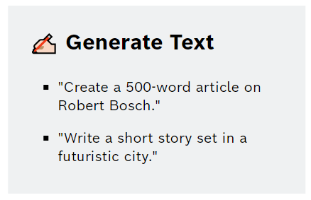
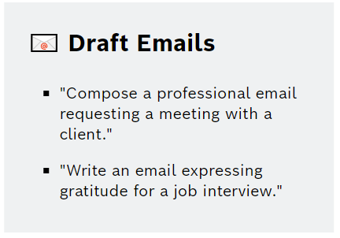
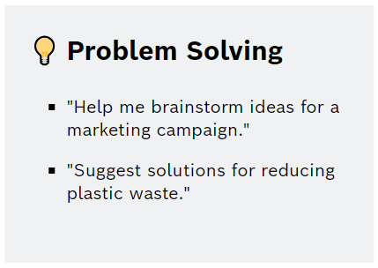
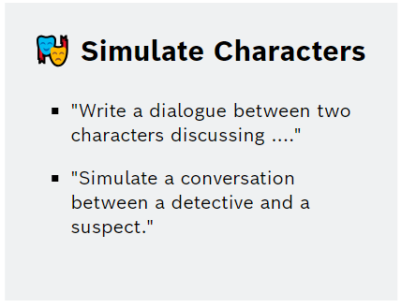
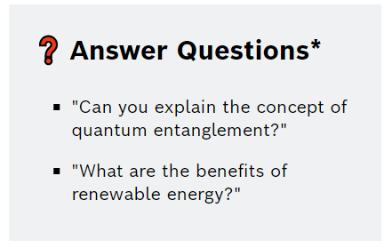
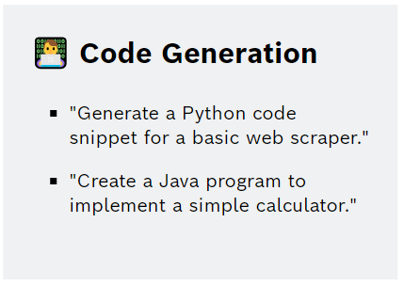
Everyday virtual assistant
AskBosch
Notes:
Source: https://inside-docupedia.bosch.com/confluence/pages/viewpage.action?pageId=3670648488

